Slide 1
 | No Shielding | With Shielding (0 depth) | With Shielding (3 cm depth)
No B field | 610 +/- 35
5 Gauss | T: 587 A: 558 | T: 585 A: 573 | T: 610 A: 614
10 Gauss | T: 600 A: 423 | T: 600 A: 470 | T: 609 A: 586
15 Gauss | T: 563 A: 272 | T: 588 A: 338 | T: 590 A: 594
20 Gauss | T: 509 A: 203 | T: 573 A: 235 | T: 570 A: 568
25 Gauss | T: 295 A: 156 | T: 594 A: 176 | T: 636 A: 526
30 Gauss | T: 59 A: 110 | T: 587 A: 129 | T: 604 A: 531

Slide 2
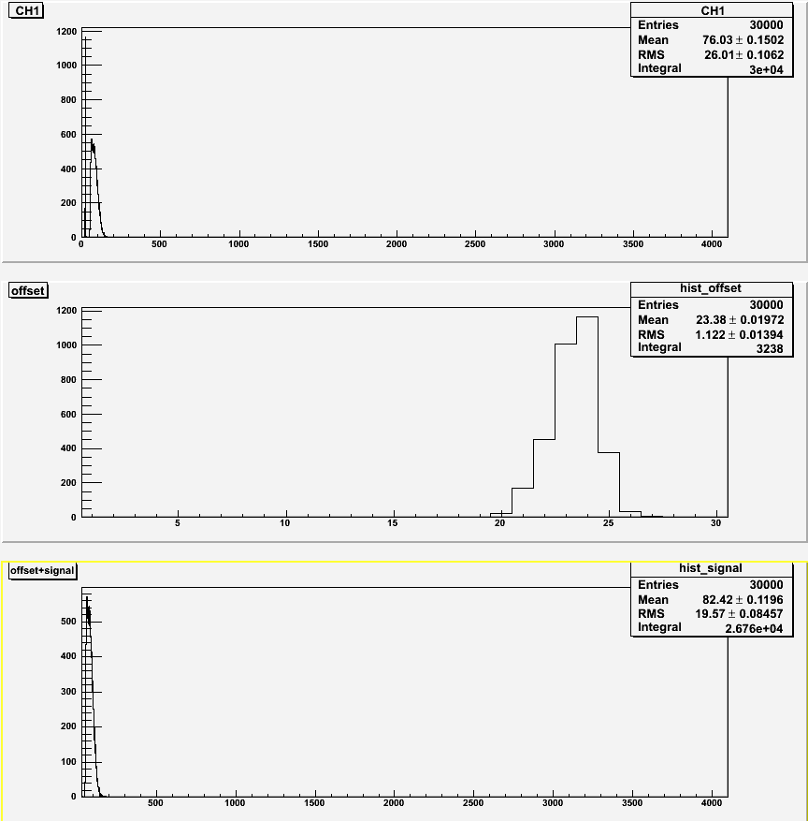
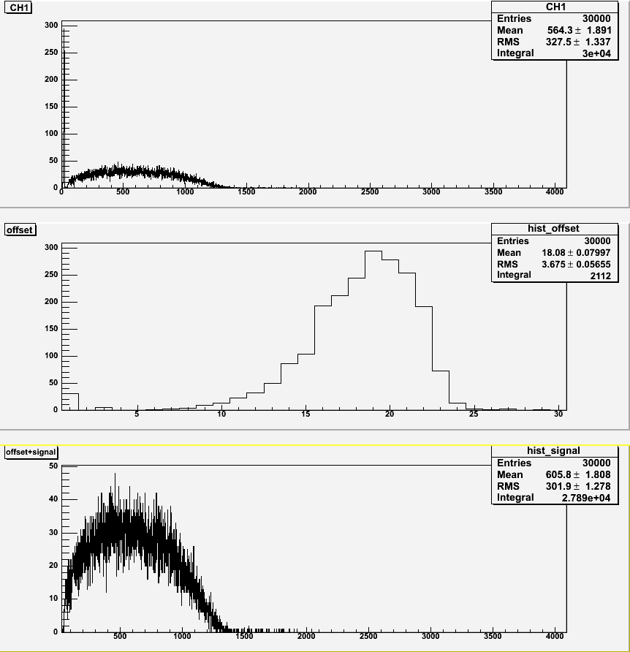
30 Gauss Transverse
No shielding
With shielding (0)

Slide 3
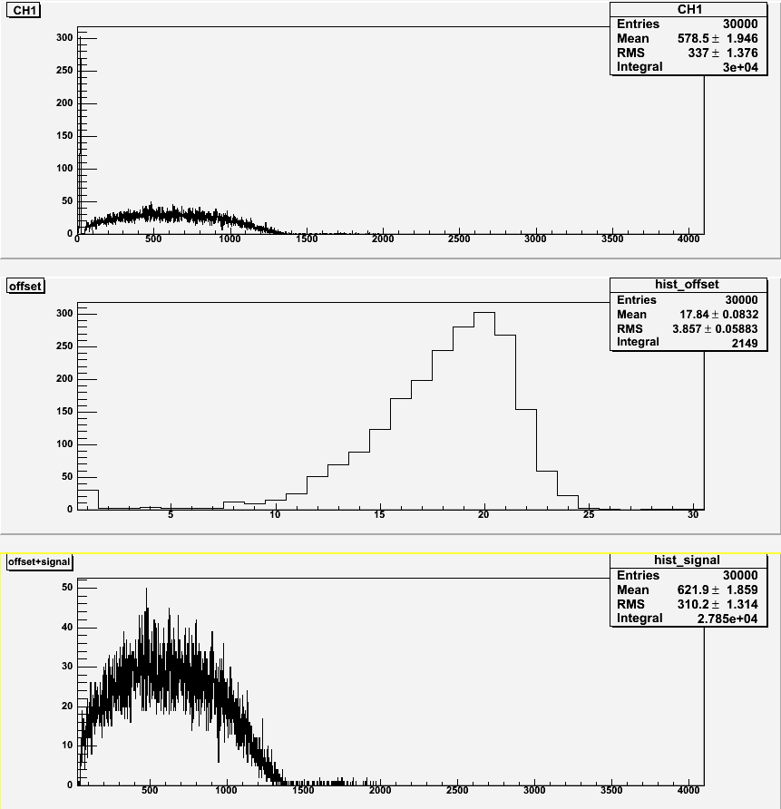
30 Gauss Transverse
With shielding (3)

Slide 4
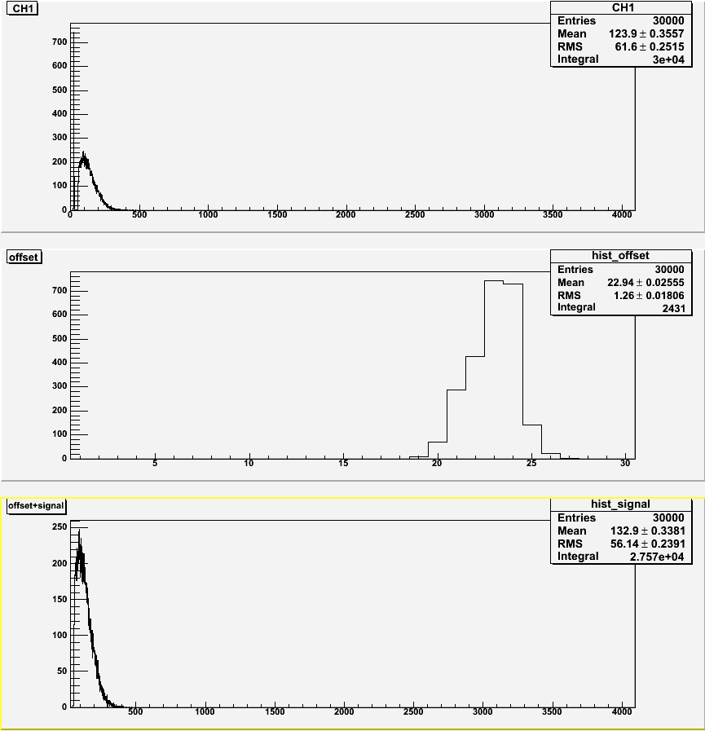
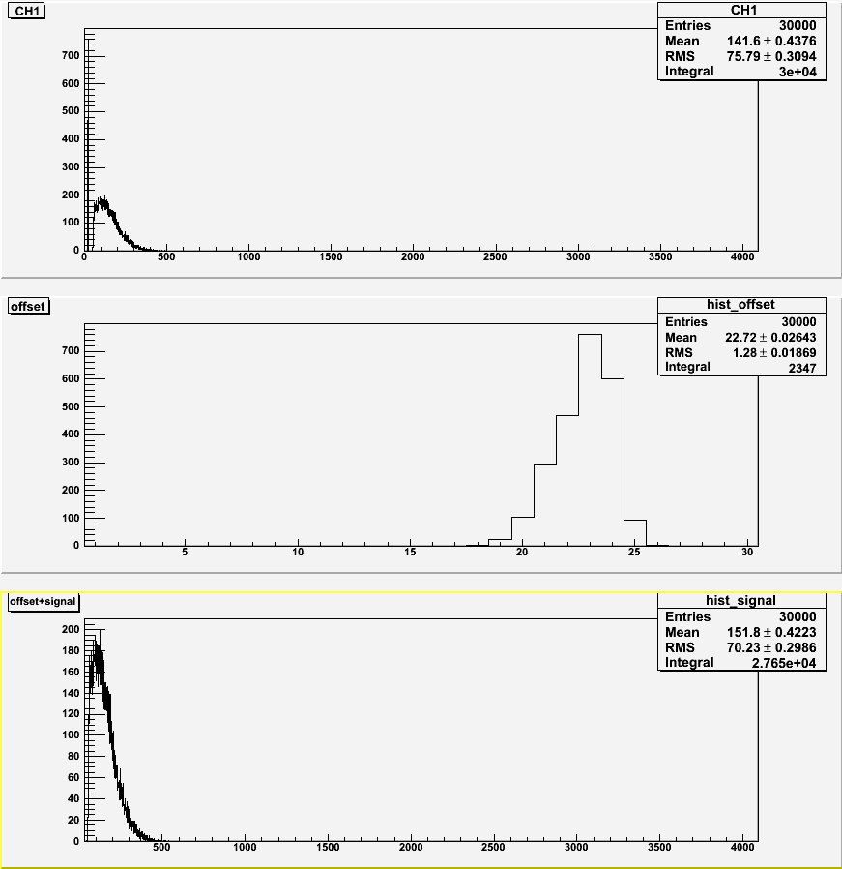
30 Gauss Axial
No shielding
With shielding (0)

Slide 5
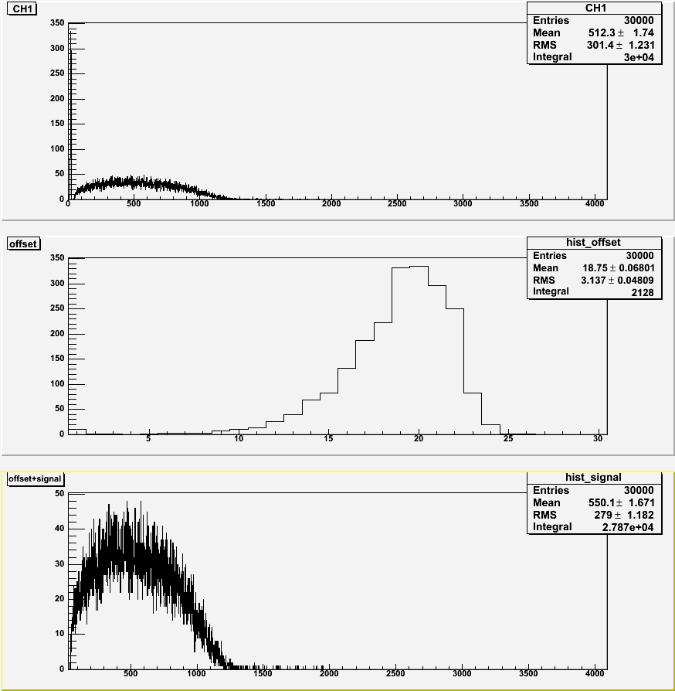
30 Gauss Axial
With shielding (3)

Slide 6
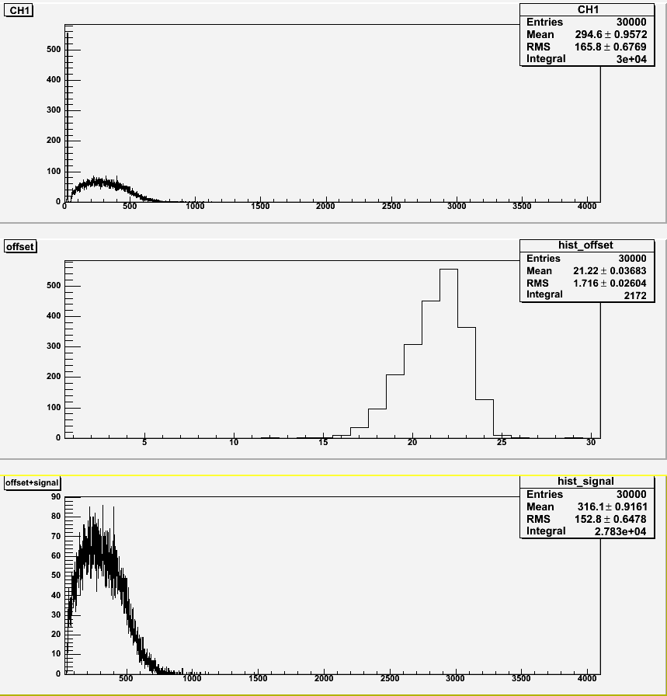
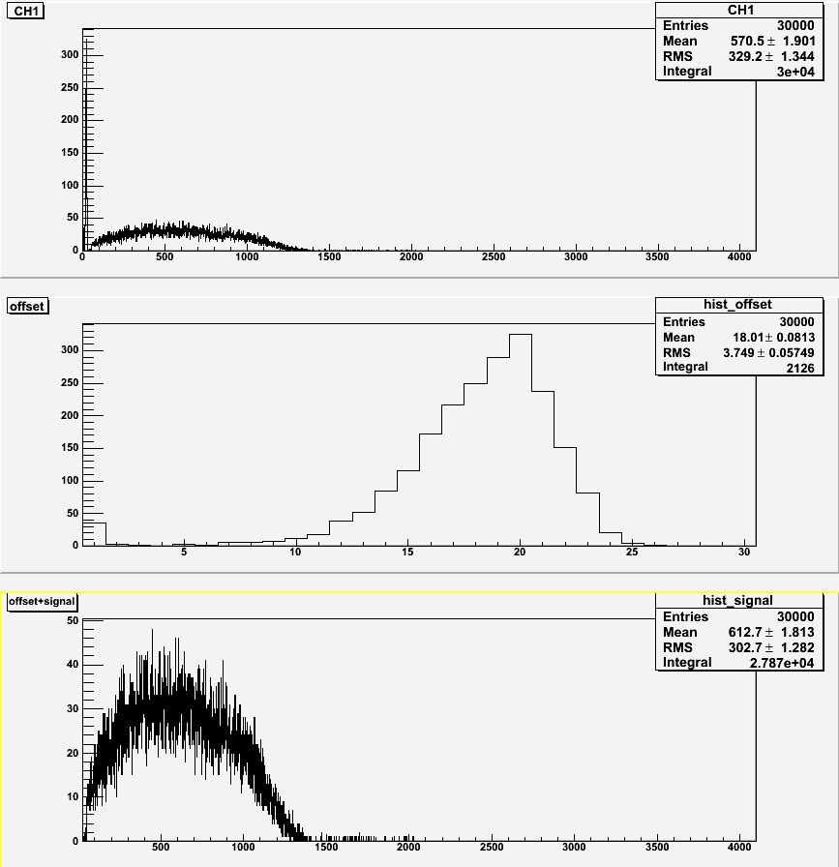
25 Gauss Transverse
No shielding
With shielding (0)

Slide 7
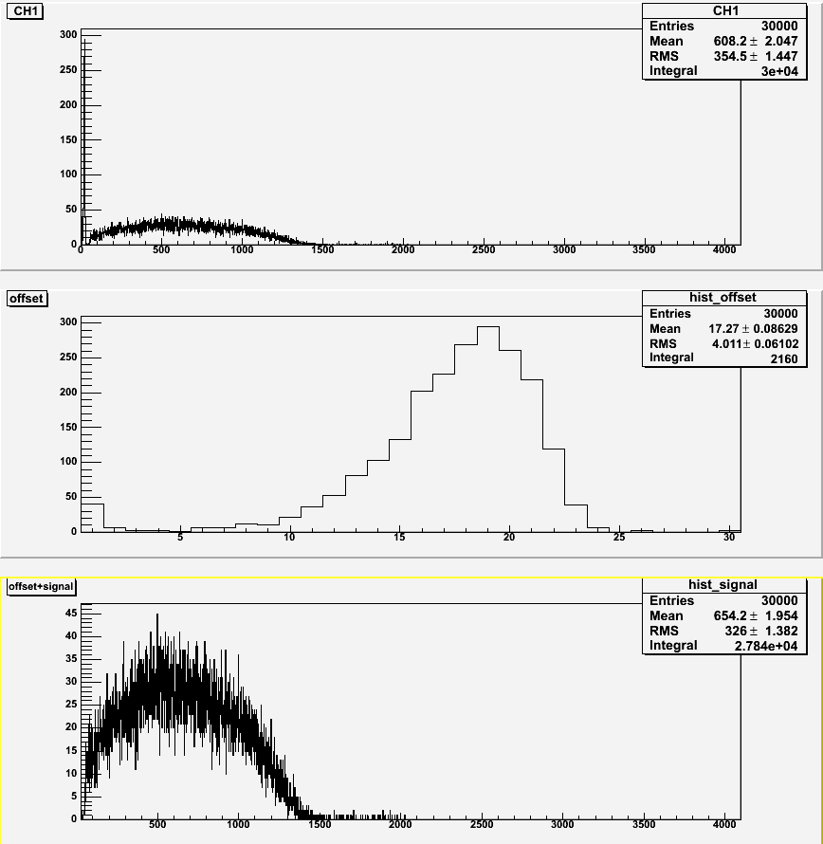
25 Gauss Transverse
With shielding (3)

Slide 8
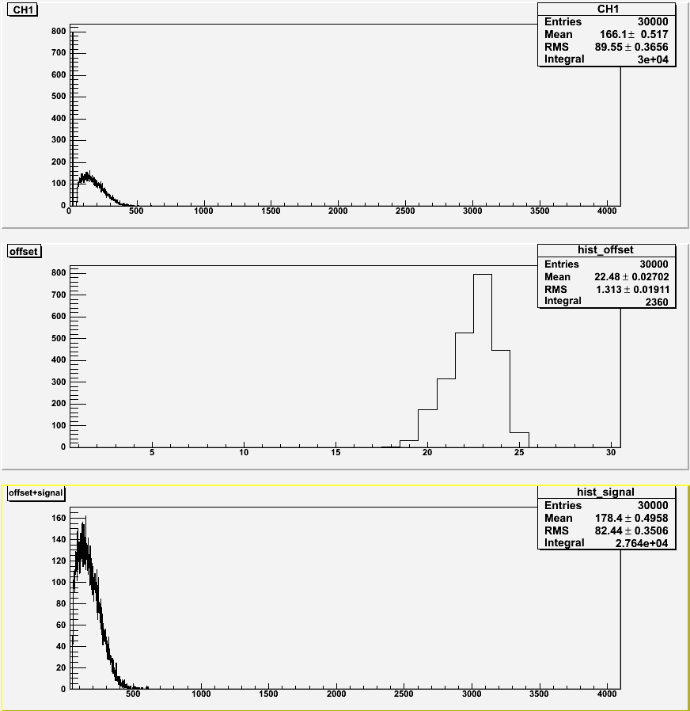
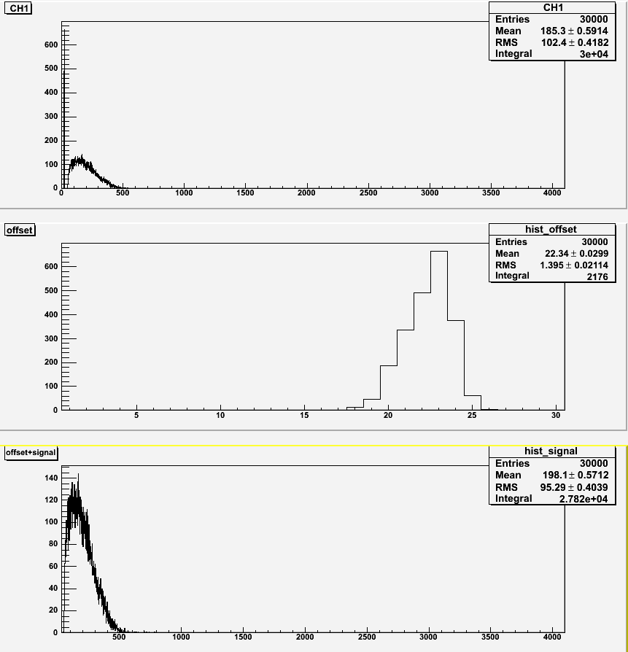
25 Gauss Axial
No shielding
With shielding (0)

Slide 9
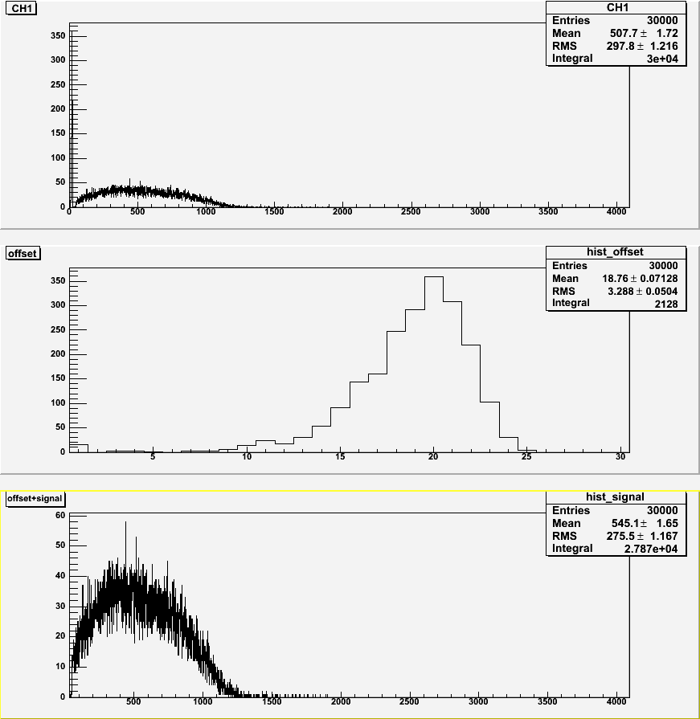
25 Gauss Axial
With shielding (3)

Slide 10
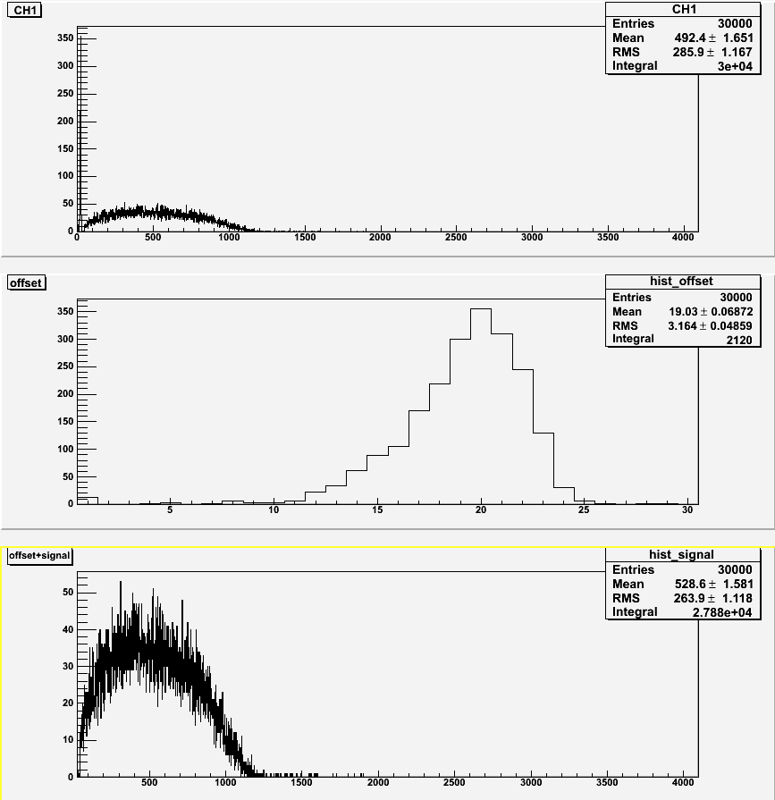
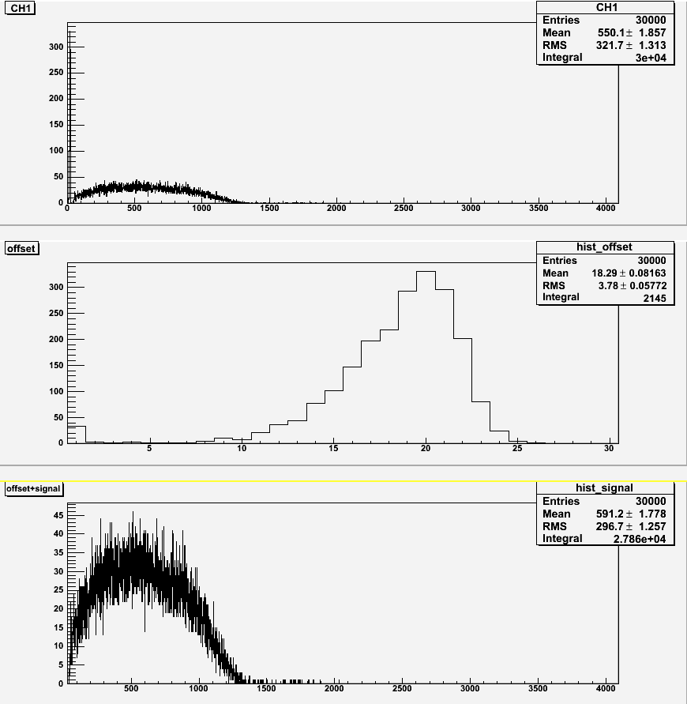
20 Gauss Transverse
No shielding
With shielding (0)

Slide 11
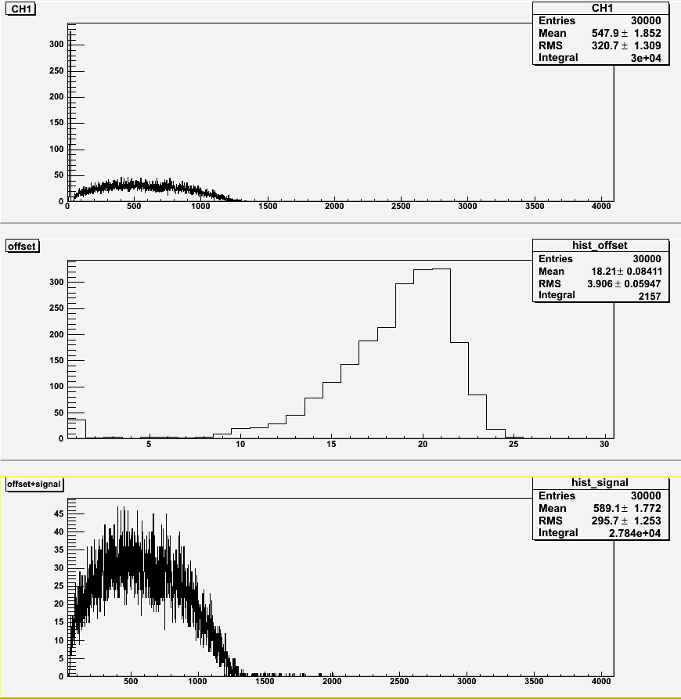
20 Gauss Transverse
With shielding (3)

Slide 12
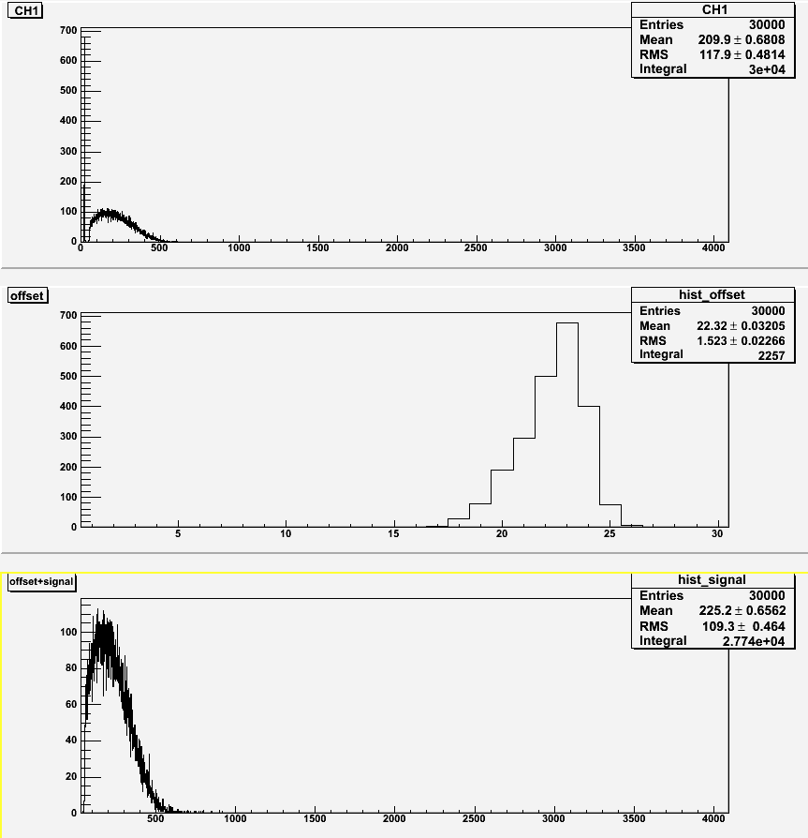
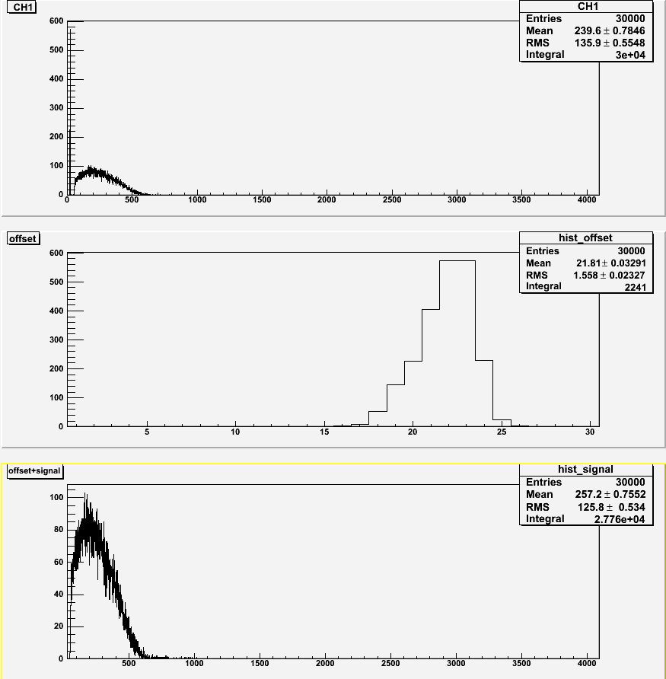
20 Gauss Axial
No shielding
With shielding (0)

Slide 13
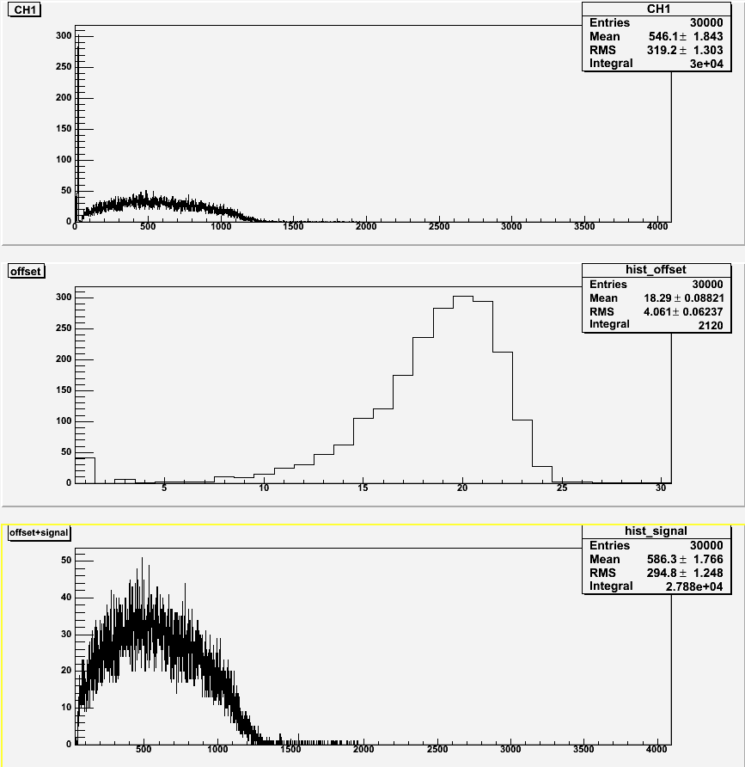
20 Gauss Axial
With shielding (3)

Slide 14
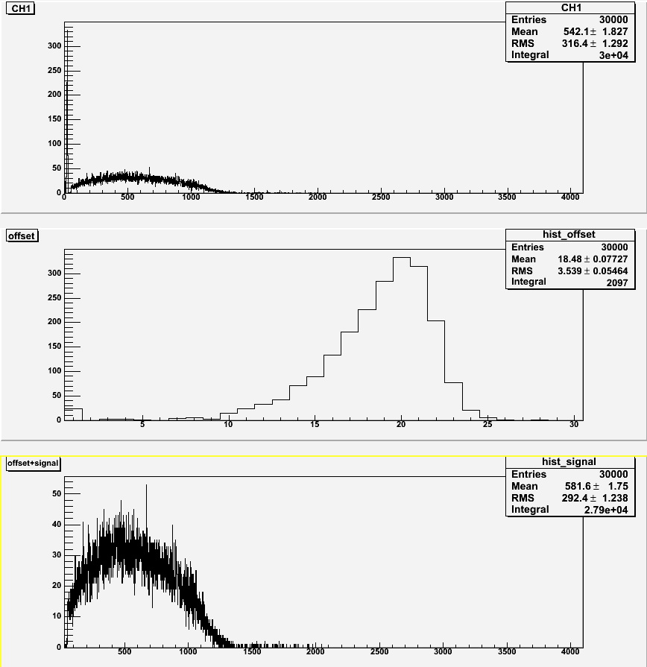
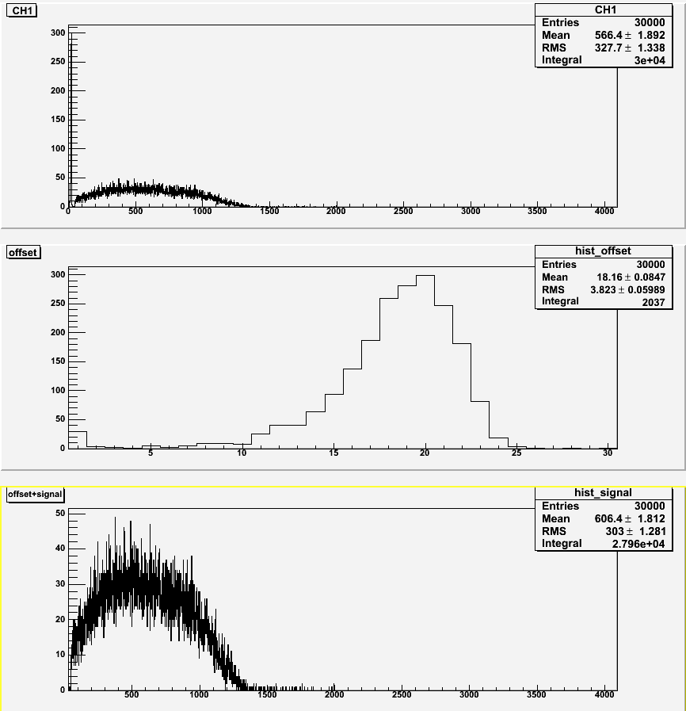
15 Gauss Transverse
No shielding
With shielding (0)

Slide 15
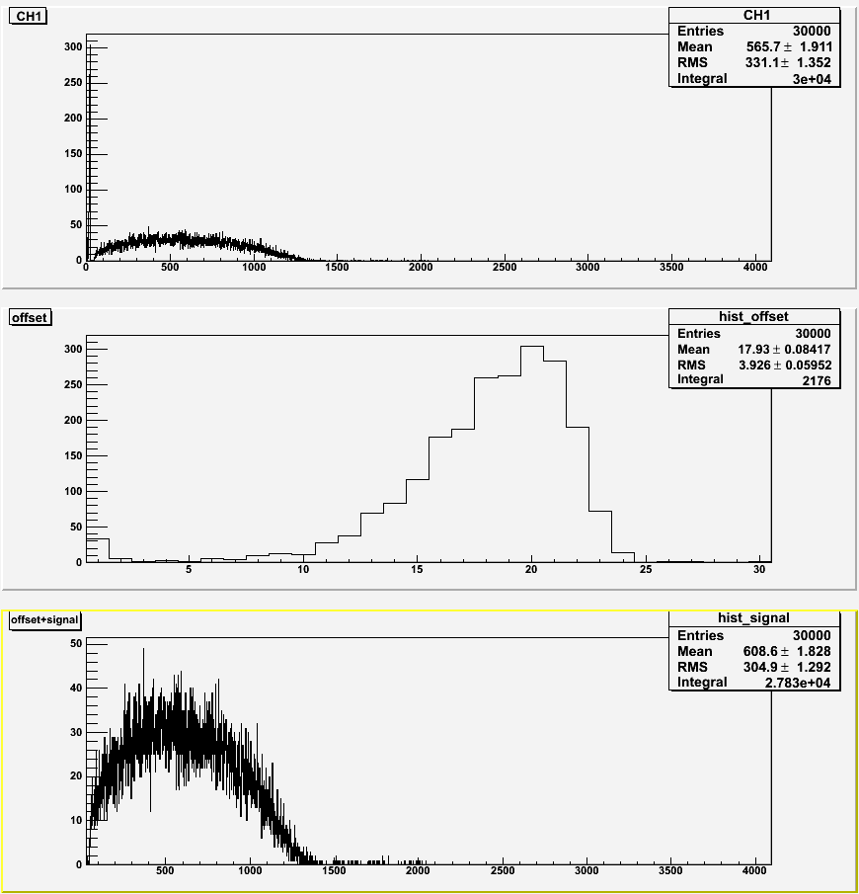
15 Gauss Transverse
With shielding (3)

Slide 16
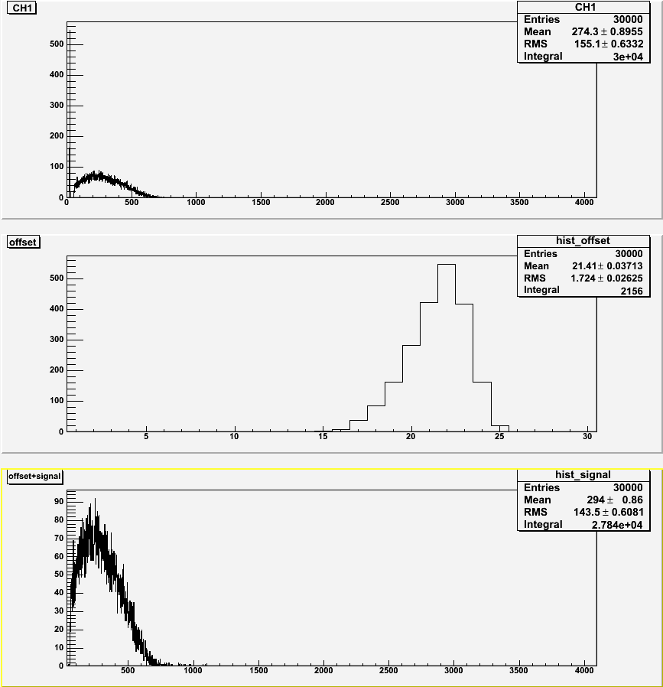
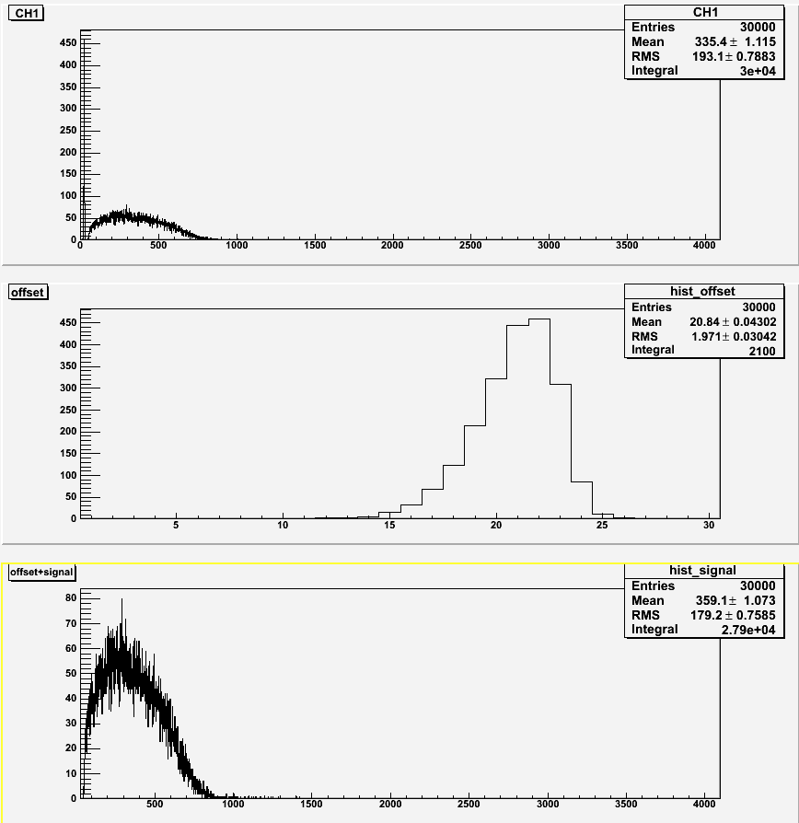
15 Gauss Axial
No shielding
With shielding (0)

Slide 17
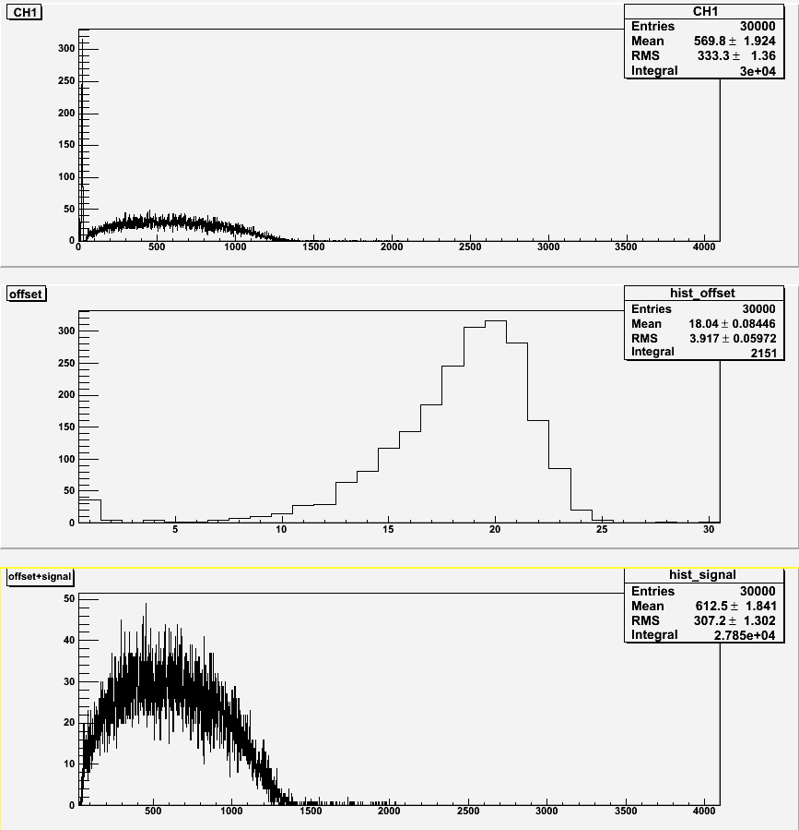
15 Gauss Axial
With shielding (3)

Slide 18
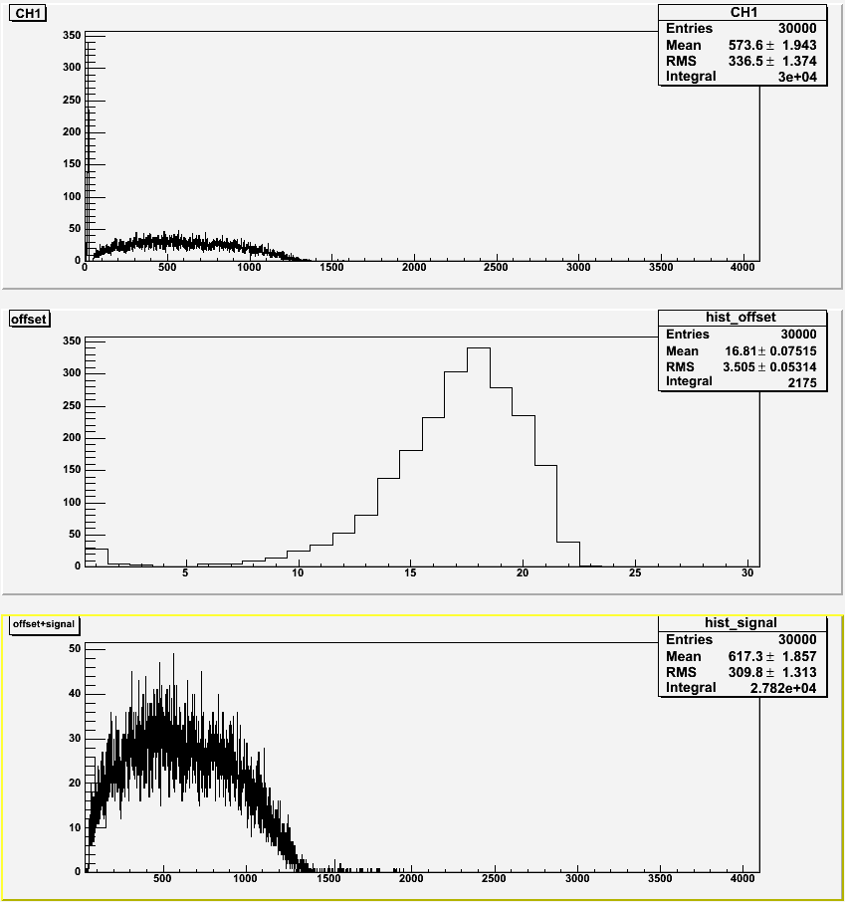
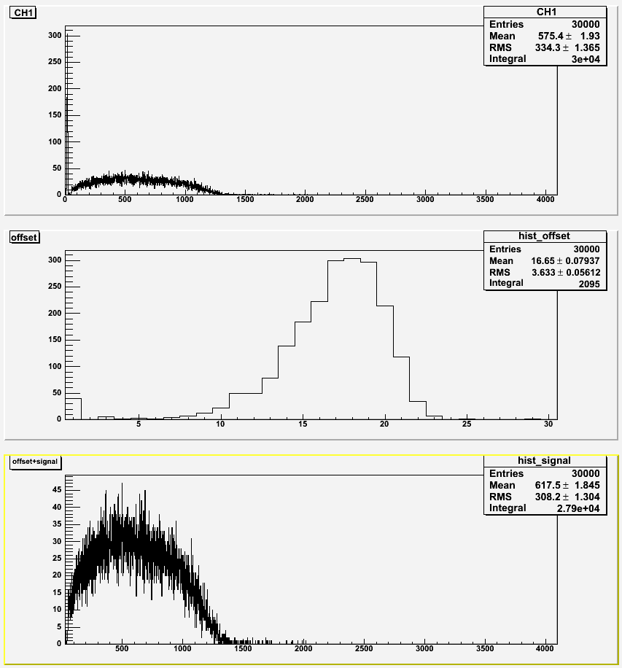
10 Gauss Transverse
No shielding
With shielding (0)

Slide 19
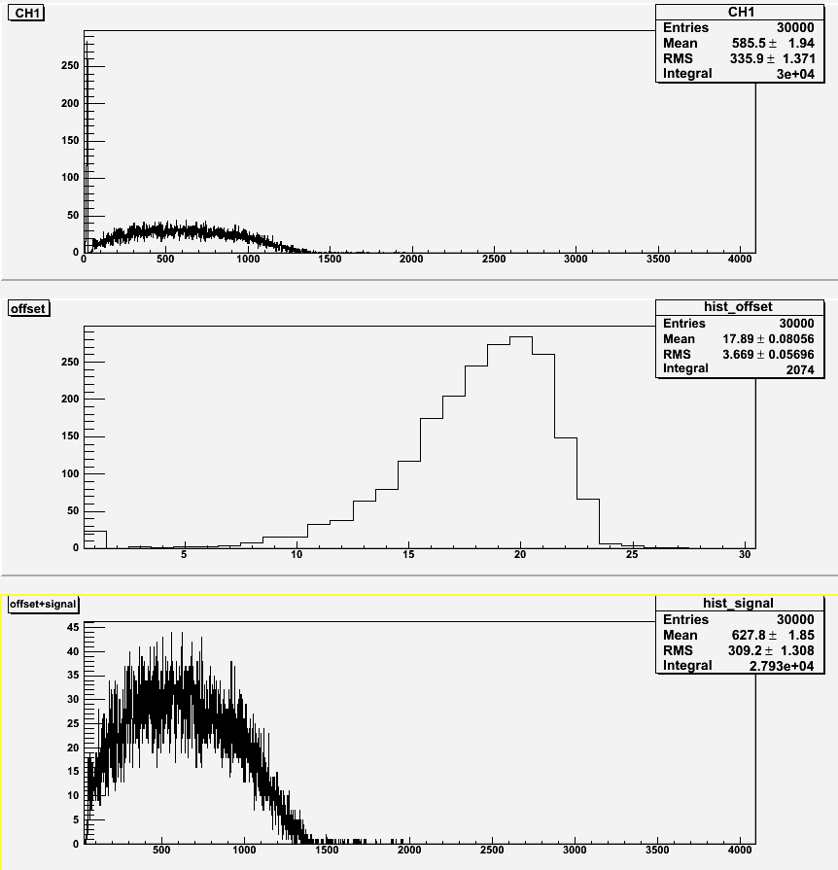
10 Gauss Transverse
With shielding (3)

Slide 20
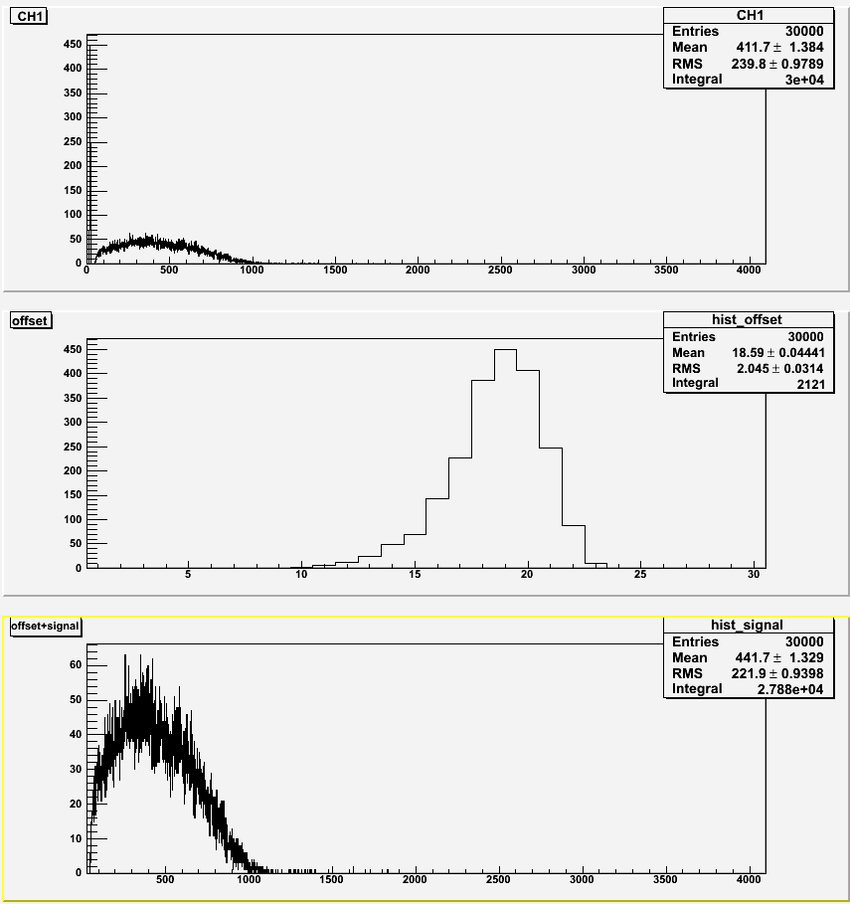

10 Gauss Axial
No shielding
With shielding (0)

Slide 21
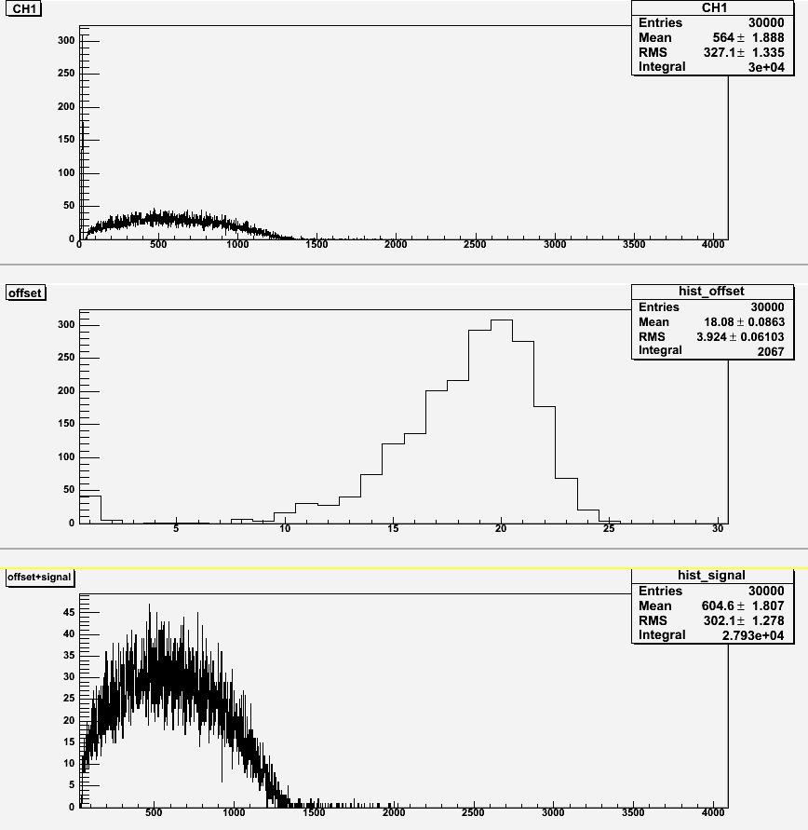
10 Gauss Axial
With shielding (3)

Slide 22
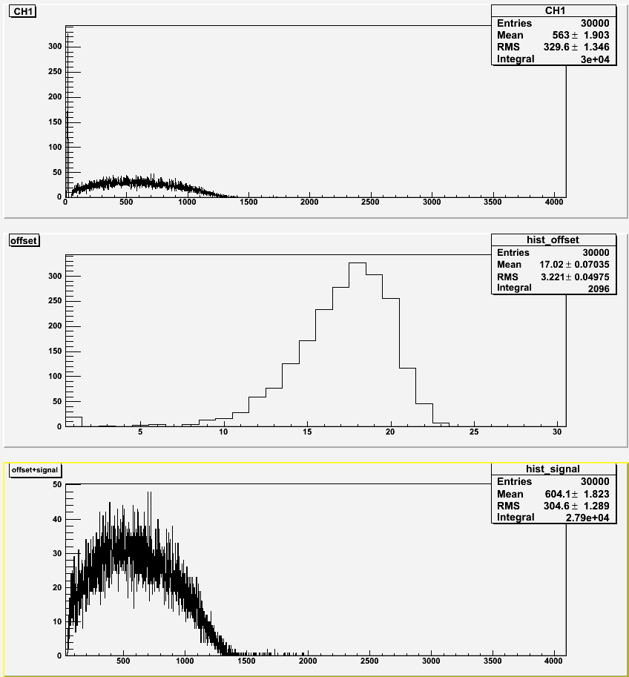
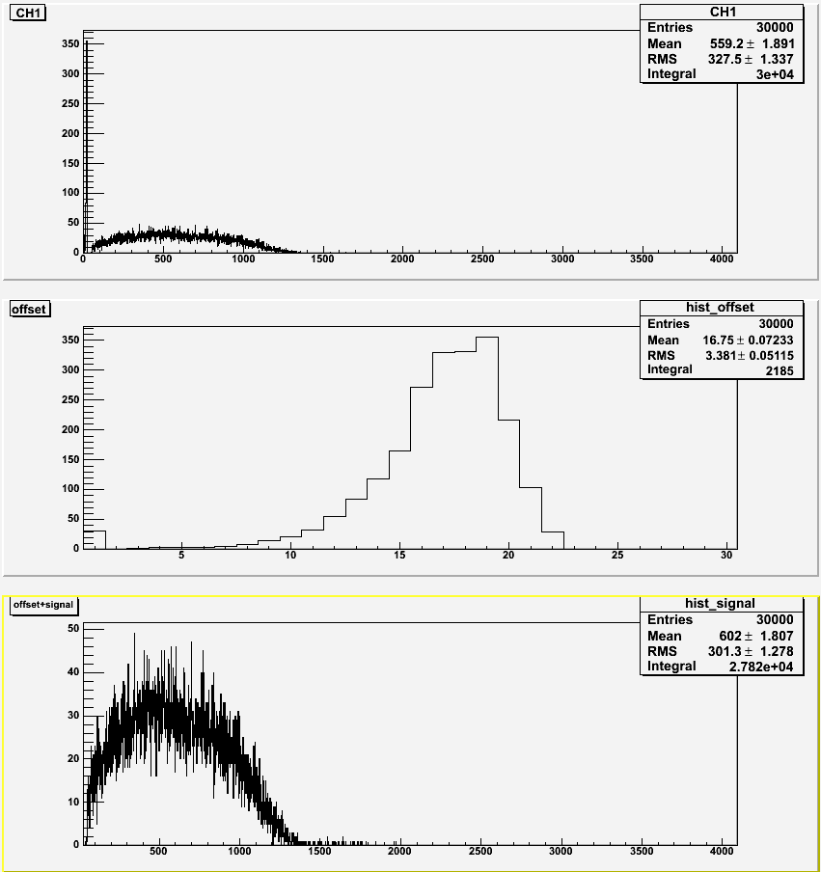
5 Gauss Transverse
No shielding
With shielding (0)

Slide 23

5 Gauss Transverse
With shielding (3)

Slide 24
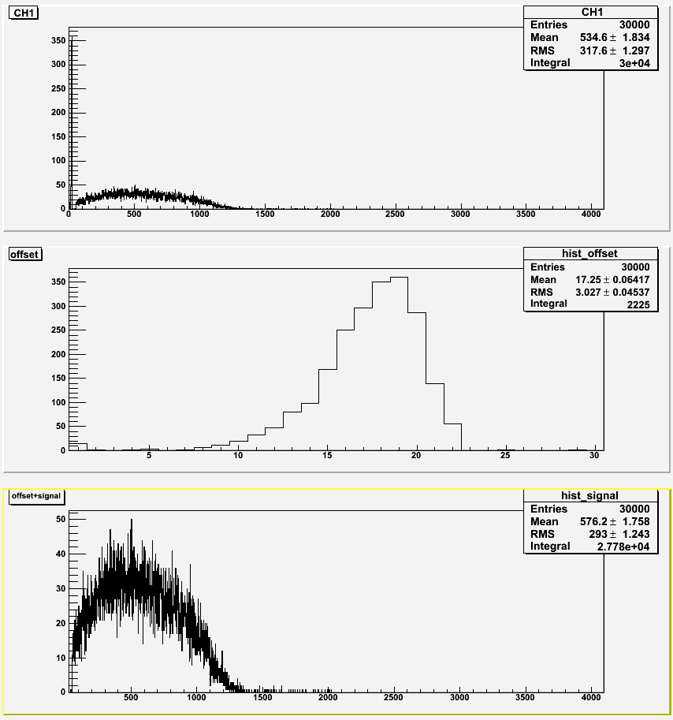
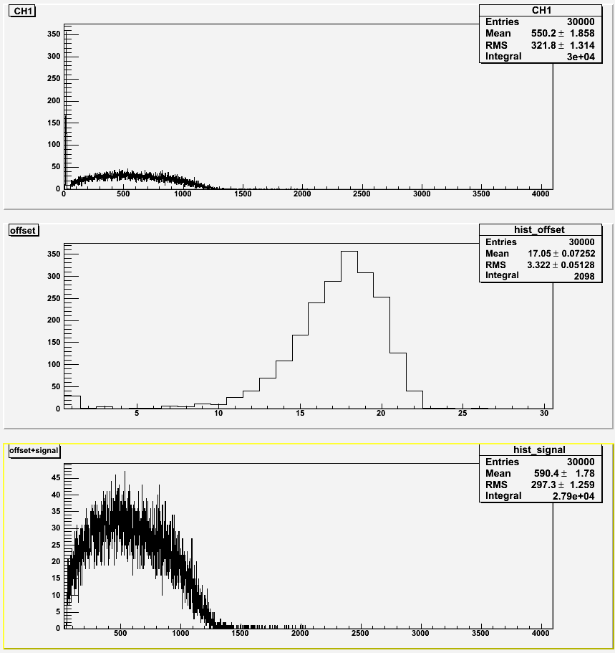
5 Gauss Axial
No shielding
With shielding (0)

Slide 25
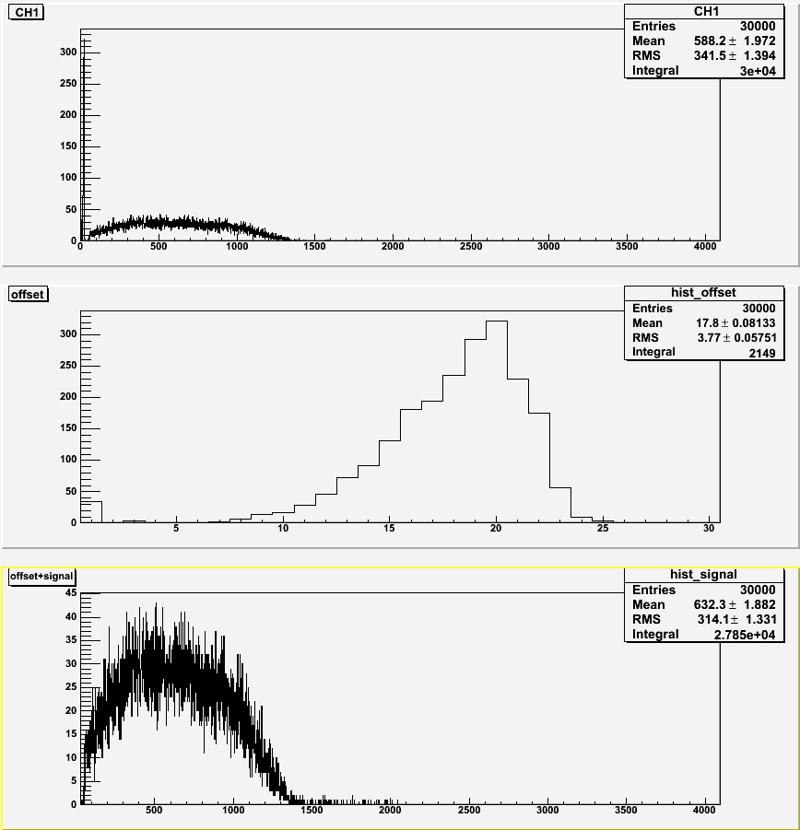
5 Gauss Axial
With shielding (3)

Slide 26
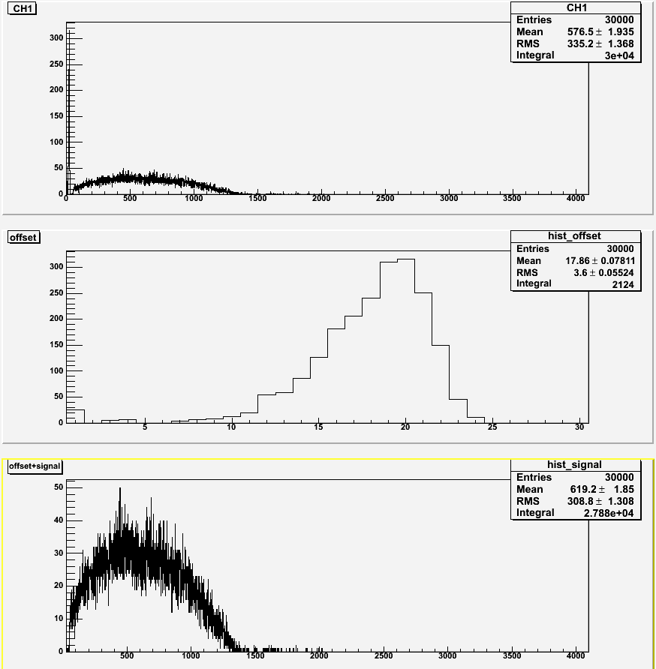
No magnetic field

